Slide 1
Python
Object-oriented programming

Slide 2
Object-oriented programming
First goal: Model the objects of the world
Noun-oriented
Focus on the domain of the program
Phases
Object-oriented analysis: Understand the domain
Define an object-based model of it
Object-oriented design: Define an implementation
Design the solution
Object-oriented programming: Build it

Slide 3
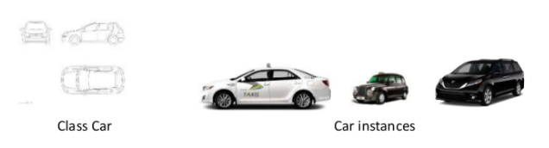
Object-oriented programming
Object in Python is a representation of a person, a place, a bank account, a car, or any item that the program should handle
OOP Recipe:
(1) define classes (these are descriptions)
(2) make object instances out of classes

Slide 4
Object-oriented programming
Creating a simple class in Python
In a class, we describe (1) how the object will look like, and (2) what behavior it will have
Classes are the blueprints for a new data type in your program
A class should have at minimum:
A name (e.g. Class Person)
A constructor method (that describes how to create a new object, __init__)
class Dog:
species = "Canis familiaris"
def __init__(self, name, age):
self.name = name
self.age = age

Slide 5
Object-oriented programming
The __init__method
__init__ is a special method in python classes
The __init__ method is the constructor method for a class
__init__ is called when ever an object of the class in constructed
Make a new object
buddy=Dog("Buddy",9)
__init__ method is called
Behaviour within the __init__ method executes
…
self.name=name.
…

Slide 6
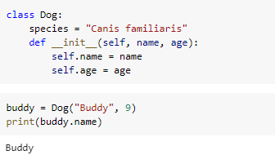
Object-oriented programming
Creating an object from the class
From one class, you make objects (instances)

Slide 7
Object-oriented programming
Behavior of a class
Classes/object can have methods just like function except that they have an extra self variable at the beginning
An object method takes as the first parameter the object (self) and can accept any number of other parameters
class Dog:
species = "Canis familiaris"
def __init__(self, name, age):
self.name = name
self.age = age
# Instance method
def description(self):
return f"{self.name} is {self.age} years old"
# Another instance method
def speak(self, sound):
return f"{self.name} says {sound}"

Slide 8
Object-oriented programming
Object vs Class Variables
Most variables are object specific (for example, the variable number of passengers in a taxi is different for every taxi that we create)
Some variables are common to all objects (for example, if we want to count the number of taxis that we have in our company)
To access a class variable within a method, we use @classmethod decorator, and pass the class to the method

Slide 9
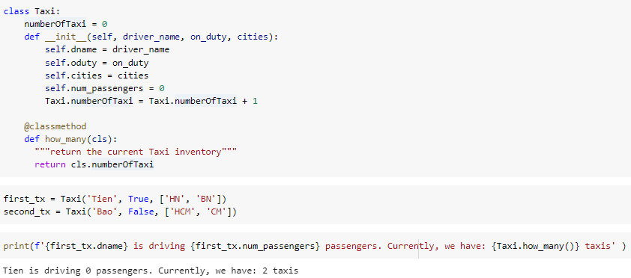
Object-oriented programming
Access Class Variables
To access a class variable within a method, we use @classmethod decorator, and pass the class to the method

Slide 10
Object-oriented programming
Inheritance
Inheritance simplifies our code through reuse of the code that has been already written
Inheritance is a relation between a parent class (e.g. Vehicle) and children classes (e.g. Taxi, Bus, Truck, etc)
A class inherits attributes and behavior methods from its parent classes

Slide 11
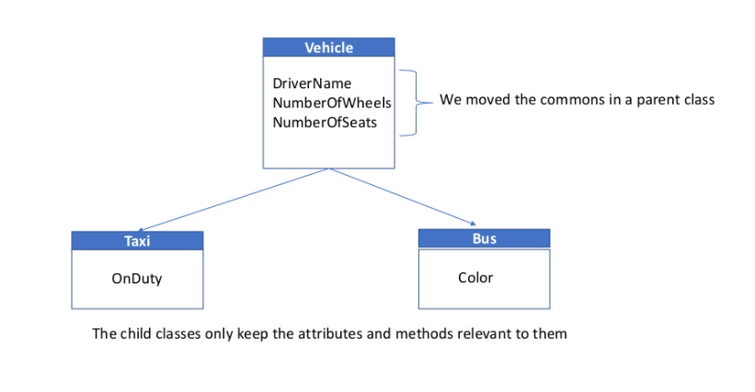
Object-oriented programming
Inheritance example

Slide 12
Object-oriented programming
Inheritance in Python
Create a parent class (e.g. Vehicle) with the common attributes and common methods.
Create child classes (e.g. Bus and Taxi) with the extended attributes and extended methods,
Pass the class definition to the child (e.g Class Bus(Vehicle): ….)
Use the parent attributes and method through super().

Slide 13
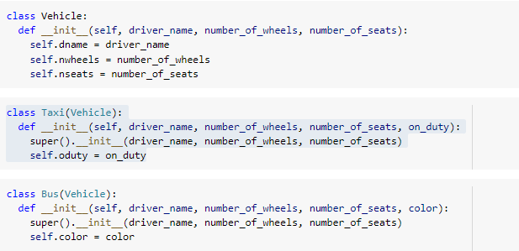
Object-oriented programming
Inheritance in Python

Slide 14
Object-oriented programming
Method Overriding
Method overriding is an object-oriented programming feature that allows a subclass to provide a different implementation of a method that is already defined by its superclass or by one of its superclasses
__init__ in the child class (e.g. Taxi) overrides the __init__ method from the parent class

Slide 15
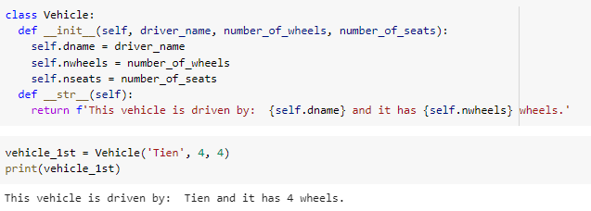
Object-oriented programming
Example of Overriding __str__
Let’s add a __str__ method that nicely prints our Vehicle details on the screen

Slide 16
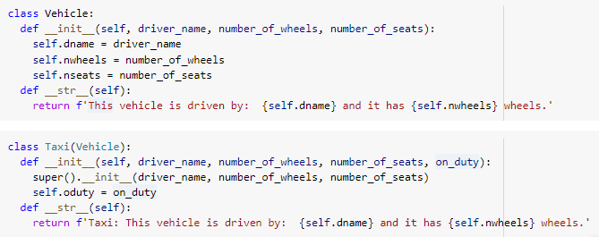

Object-oriented programming
Example of Overriding __str__

Slide 17
Object-oriented programming
Object-relational mapping (ORM)
ORMs help you a lot in writing complex CRUD operations, which are a pain to write via manual SQL
Create a new object in a database
Update an object in a database
Delete an object from database
We will use peewee in this course to try-out object-relational mapping

Slide 18
Object-oriented programming
ORM Approach with peewee
Import peewee
Set the database name
Create the class for the Vehicle by inheriting from peewee.Model
Create the table for the class
Create a few instances of the Vehicle
Save them in the database

Slide 19
Object-oriented programming
ORM Approach with peewee
Import peewee
Set the database name
# We first import the ORM
import peewee as pw
# We set the name of the Sqlite database
db = pw.SqliteDatabase('vehicle.db')

Slide 20
Object-oriented programming
ORM Approach with peewee
3. Create the class for the Vehicle by inheriting from peewee.Model
class Vehicle(pw.Model):
"""
ORM model of the Vehicle
"""
dname = pw.TextField()
nwheels = pw.IntegerField()
nseats = pw.IntegerField()
class Meta:
'''
we connect the database to the models via the nested class
'''
database = db

Slide 21
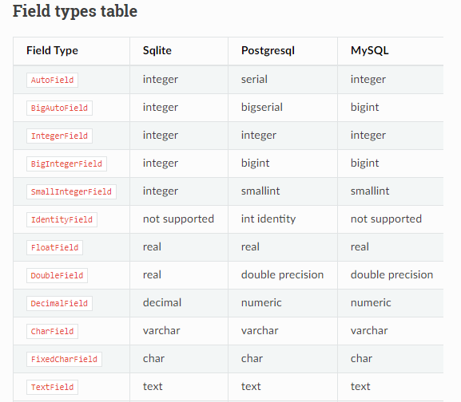
Object-oriented programming
ORM Approach with peewee

Slide 22
Object-oriented programming
ORM Approach with peewee
4. Create the table for the class
try:
Vehicle.create_table()
except pw.OperationalError:
print('Vehicle table already exists')

Slide 23
Object-oriented programming
ORM Approach with peewee
5. Create a few instances of the Vehicle
6. Save them in the database
vh_1 = Vehicle(dname ='Tien A', nwheels=4, nseats=5)
vh_2 = Vehicle(dname ='Tien B', nwheels=4, nseats=6)
vh_3 = Vehicle(dname ='Tien C', nwheels=8, nseats=7)
vh_1.save()
vh_2.save()
vh_3.save()

Slide 24
Object-oriented programming
Other peewee things
You can query for items in a database
You can update item using .save()
You can set primary and foreign keys
….

Slide 25
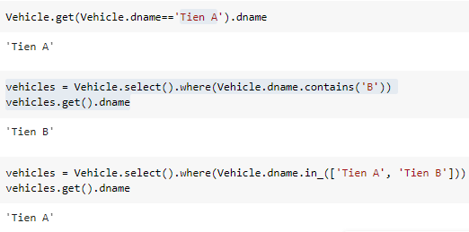
Object-oriented programming
Other peewee things
You can query for items in a database

Slide 26

Thank you

